Slide 1
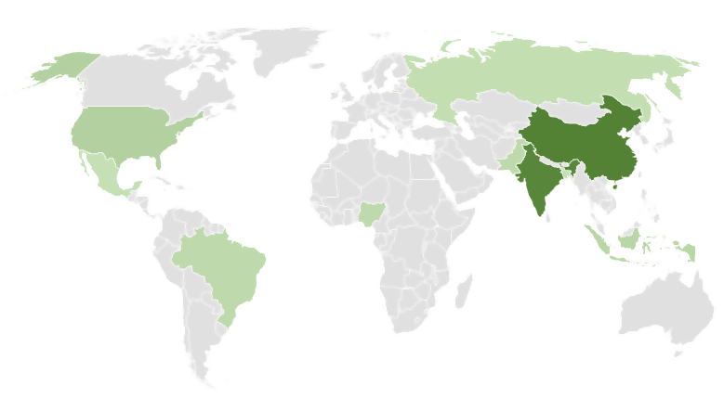
5 charts you didn’t think you could make in Excel
Select any cell within your data range:
1
Map
China
1,398.5
India
1,350.6
United States
329.7
Use a map chart when you have geographical regions in your data, like counties, states, or countries.
Indonesia
268.1
Brazil
210.3
Pakistan
205.6
Nigeria
201.0
Bangladesh
167.0
Russia
146.8
Mexico
126.6
Available only in Office 365 and Office 2019
Then select Insert > Charts > >Maps > Filled Map.
More details

Slide 2
Waterfall
2
Select any cell within your data range:
Revenue
23
Show a running total as values are added or subtracted.
Cost of goods
(8)
Gross margin
15
Admin expense
(1)
Net income
14
Then select Insert > Charts > Insert Waterfall, Funnel, Stock, Surface, or Radar > Waterfall.
More details
3
Funnel
Select any cell within your data range:
Prospects
500
Show values across multiple stages in a process.
Needs analysis
300
Price quotes
150
Negotiations
80
Closed sales
35
Then select Insert > Charts > Insert Waterfall, Funnel, Stock, Surface, or Radar > Funnel.
More details

Slide 3
Bubble
4
Select any cell within your data range:
Products
Sales
Share
Visually emphasize specific values with different bubble sizes.
5
$6
3%
14
$12
12%
20
$60
33%
18
$24
10%
22
$32
42%
Then select Insert > Charts > Insert Scatter (X,Y) or Bubble Chart > 3-D Bubble.
More details
5
Combo
Select any cell within your data range:
Temp
Precip
Add a secondary axis to show different values than the original axis.
Jan
47
4.8
Apr
59
2.7
Jul
76
0.8
Oct
60
3.4
Then select Insert > Charts > Combo > Clustered Column – Line on Secondary Axis.
More details
For more information, visit aka.ms/ExcelHelpCenter

