Slide 1
TED TALK FINAL
THURSDAY (Feb 11) - 8 PM

Slide 8
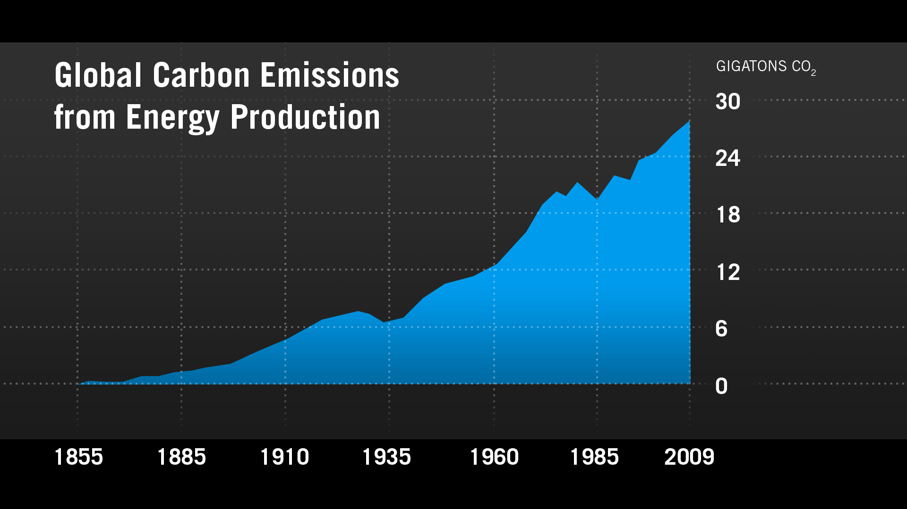

Slide 26
2050 REPORT CARD
80% Reduction
in CO₂ Emissions
Zero-emission Innovation Deployed in Developed World

Slide 27
2020 REPORT CARD
2050 REPORT CARD
20% Reduction
in C0₂ Emissions
80% Reduction
in CO₂ Emissions
Zero-emission Innovation Progress
Zero-emission Innovation Deployed in Developed World

Slide 28
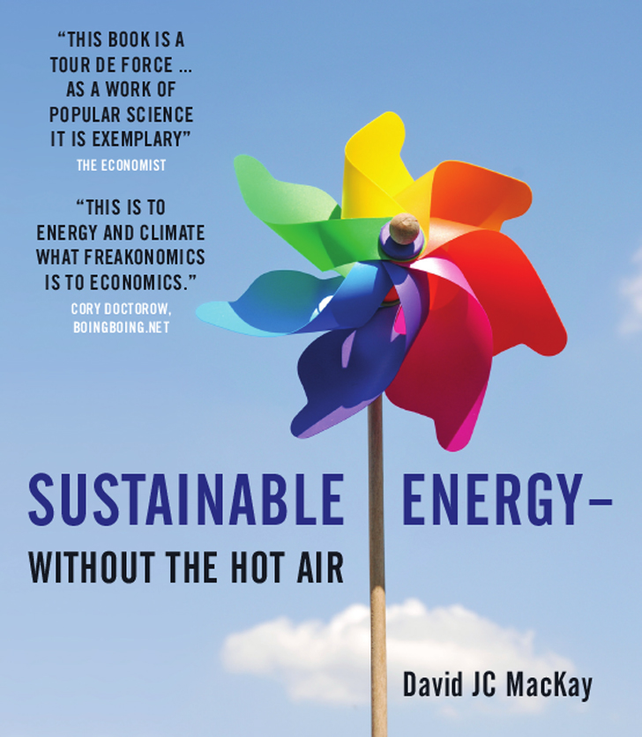

Slide 29
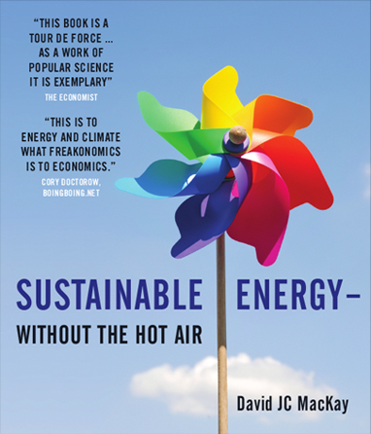
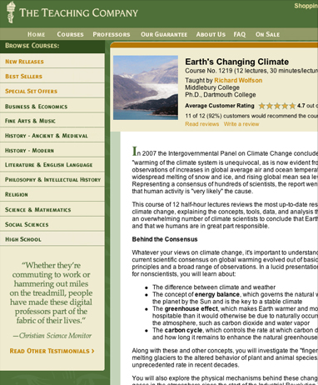

Slide 35
APPENDIX

Slide 36
ORIGINAL

Slide 37
Editable in case you need to change
In case you need to edit
Basic Research Funding
Market Incentives
to Reduce CO₂
Entrepreneurial
Opportunity
Regional
Regulatory Framework

Slide 38
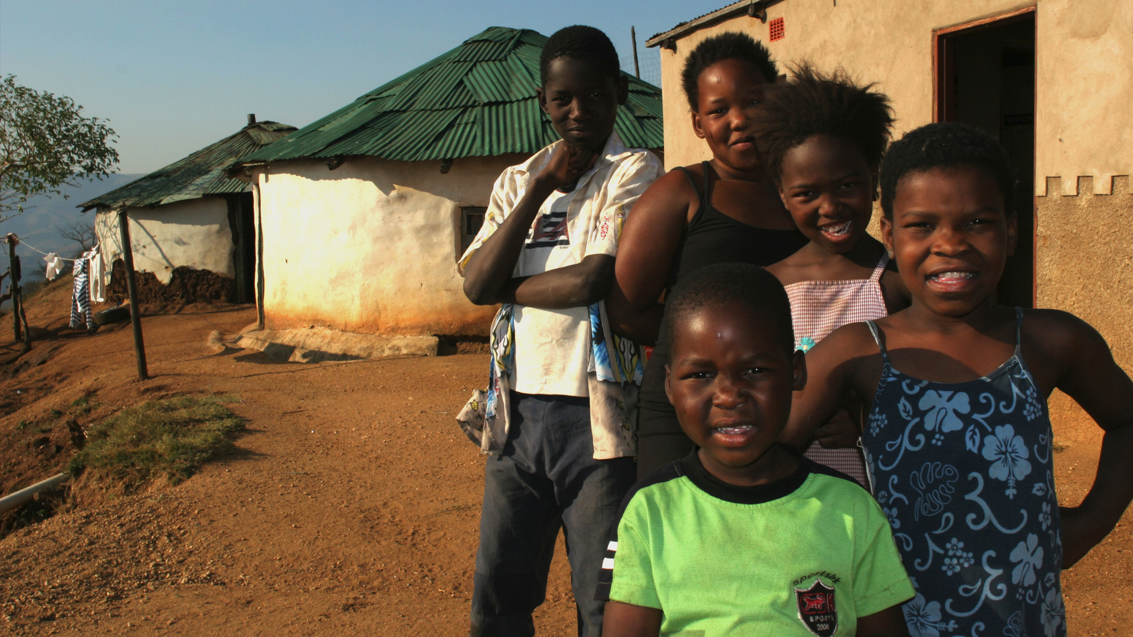
Alternative to Teening Masses

Slide 39
Alt with all white text

Slide 40
Editable
2020 REPORT CARD
2050 REPORT CARD
2020 ~20% Emissions Reductions
Technology Breakthroughs
in Place Worldwide
2020 Technology Miracles Progress
100% CO₂ Emission Reduction

Slide 41
Editable
2020 REPORT CARD
2020 ~20% Emissions Reductions
2020 Technology Miracles Progress

Slide 49
2020 REPORT CARD
2050 REPORT CARD
20% Reduction
in C0₂ Emissions
80% Reduction
in CO₂ Emissions
Zero-emission Innovation Progress
Zero-emission Innovation Deployed in Developed World

