Slide 1
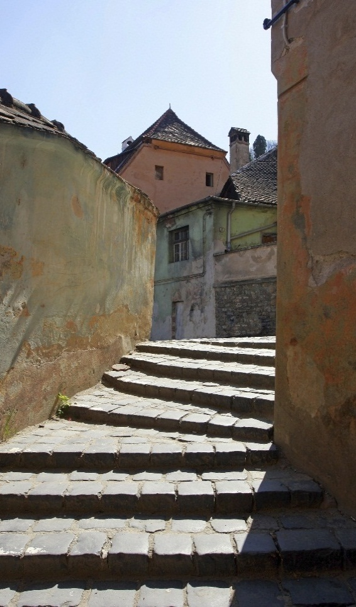
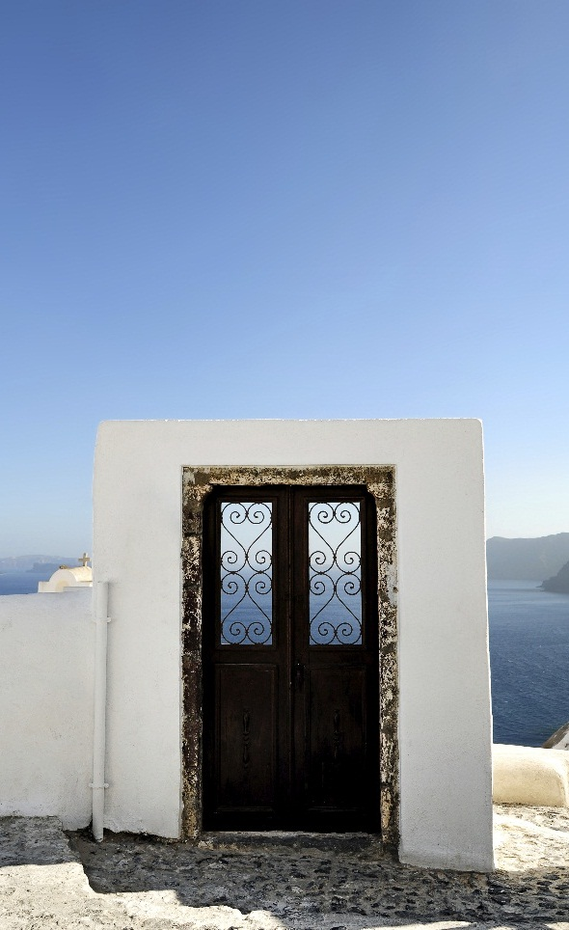
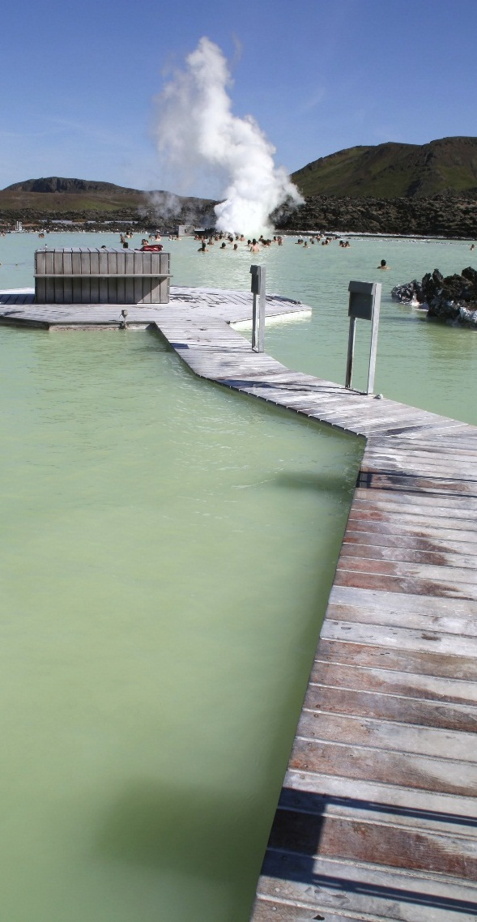
margie’s
travel
“We recommend Margie’s Travel to anyone who will listen to us. They anticipated every need and solved every potential stressor.”
~ Henriette Andersen
margie’s travel
4567 Main Street
Raleigh, NC 02134
(718) 555-1234
contact@margiestravel.com
www.margiestravel.com
Notes:
To change this brochure, replace our sample content with your own. Or, if you'd rather start from a clean slate, press the New Slide button on the Home tab to insert a new page. Now enter your text and pictures in the empty placeholders. If you need more placeholders for titles, subtitles or body text, copy any of the existing placeholders, then drag the new one into place.
And did you notice we made fold marks for you? They are really light, but if you don’t like them showing on your brochure, select and delete them before you print.

Slide 2
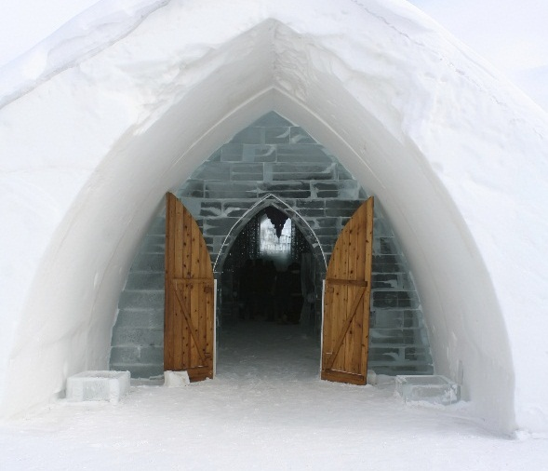
“We don’t merely book your travel; we can help you realize your travel dreams if you give us an idea of what kind of experience you seek.”
Service Benefits
Through our extensive partner network, we provide you with superior travel services including:
Passport expediting
Excursion planning
Hotel, air, transportation arrangements
Trip insurance
Services Offered
About us
When you contact Margie’s Travel, you’re dealing with the best. We offer experience and versatility, so you get:
Booking for any type of travel
Quick, thorough, knowledgeable responses to calls and questions
Resourceful and well-traveled agents
Margie’s Travel is the leading go-to company when you want to get going. Serving the Raleigh community for more than 20 years, we pride ourselves on our elevated service standards and unequaled reputation for courtesy and follow-through.
Henriette Andersen and her sister had never left the town of Raleigh and wanted to go on a tropical adventure, but they were nervous about the possibility of getting ill or lost in another country.
Our agent put together a fool-proof vacation, including checklists, trusted contacts in the vacation spot, and other resources. The sisters returned and were eager for more international travel.
Key Clients
Our reliability and award-winning customer service earned us an impressive client list including:
Northwind Traders
Fabrikam
Contoso Limited
Adventure Works
Notes:
To change this brochure, replace our sample content with your own. Or, if you'd rather start from a clean slate, press the New Slide button on the Home tab to insert a new page. Now enter your text and pictures in the empty placeholders. If you need more placeholders for titles, subtitles or body text, copy any of the existing placeholders, then drag the new one into place.
And did you notice we made fold marks for you? They are really light, but if you don’t like them showing on your brochure, select and delete them before you print.

